Slide 1

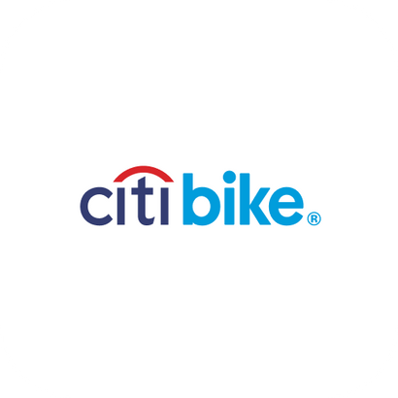
CITI BIKE
Presented by Lyft

Slide 2

WHAT IS CITI BIKE?
Originally Launched:
May 2013 in New York City, NY
Purpose of Citi Bike:
Fun and efficient shareable transportation option
How it Does it Work?
Dock. Unlock. Ride. Return.
The Convenience:
Accessible, eco-friendly, healthy, convenient, affordable

Slide 3




THE MAIN ISSUES
Unreliable Service & Poor Maintenance
Lack of Proper Distribution
Variety of
Competitors
Broken Bikes
Empty Stations
Slow Repairs
Balanced Bikes for Every Borough
"Too Many Here, None There."
Create Brand Loyalty
Incentivize Customers

Slide 4
THE RELAUNCH
CITI BIKE REVOLVE
“SMARTER, FASTER, SMOOTHER"
REWARD AND RE-DOCK
Citi Bike users earn rewards for dropping bikes at less crowded docks
App notifications guiding users to nearest docks
Improves distribution, beats competitors, and reduces maintenance tasks

Slide 5



FINANCIAL STANDING OF TARGET CUSTOMERS
Annual Members
Casual Users
Delivery Riders
Middle- to Upper-middle income earners
Already spend $127-$200 yearly on memberships
Tourists & students
Price-sensitive
Respond well to flexible value bundles & packages
Use bikes daily
Prioritizes durability, availability, & cost efficiency
Earn $10-$15 hourly

Slide 6
CITI BIKE ADVANTAGES
Dense Station Network: Largest in NYC
Local Branding: Synonymous with NYC bike culture
Trusted with NYC’s DOT: City-backed
Sustainability-first image with strong ESG appeal for investors

Slide 7
TIMELINES TO MARKET
Phase 1:
Research & Plan
(0-3 months)
Finalize technological requirements
Conduct focus groups & pilot testing in select neighborhoods
Secure funding and partnerships
Phase 2:
Develop & Test
(4-9 months)
App updates coded and tested
Infrastructure upgrades
Begin station electrification and fleet expansion
Phase 3:
Soft Launch
(10-12 months)
Limited rollout of new features in select zones
Marketing campaigns targeting early adopters
Monitor performance and gather feedback
Phase 4:
Full Launch & Scale
(12-18 months)
City-wide deployment
Expansion of rewards program & increased incentives
Optimization based on user engagement

Slide 8
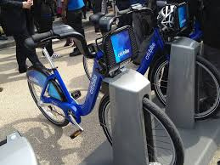
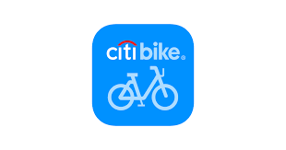
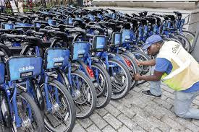
DEVELOPMENT & PRODUCTS
App Notification & Optimization
Improved Distribution & Maintenance Reduction
Rewards & Re-Docking
Integrate rewards
system within the
Citi Bike app
GPS-based app guide users to less crowded docks
Fleet management logistics for redistribution of bikes

Slide 9
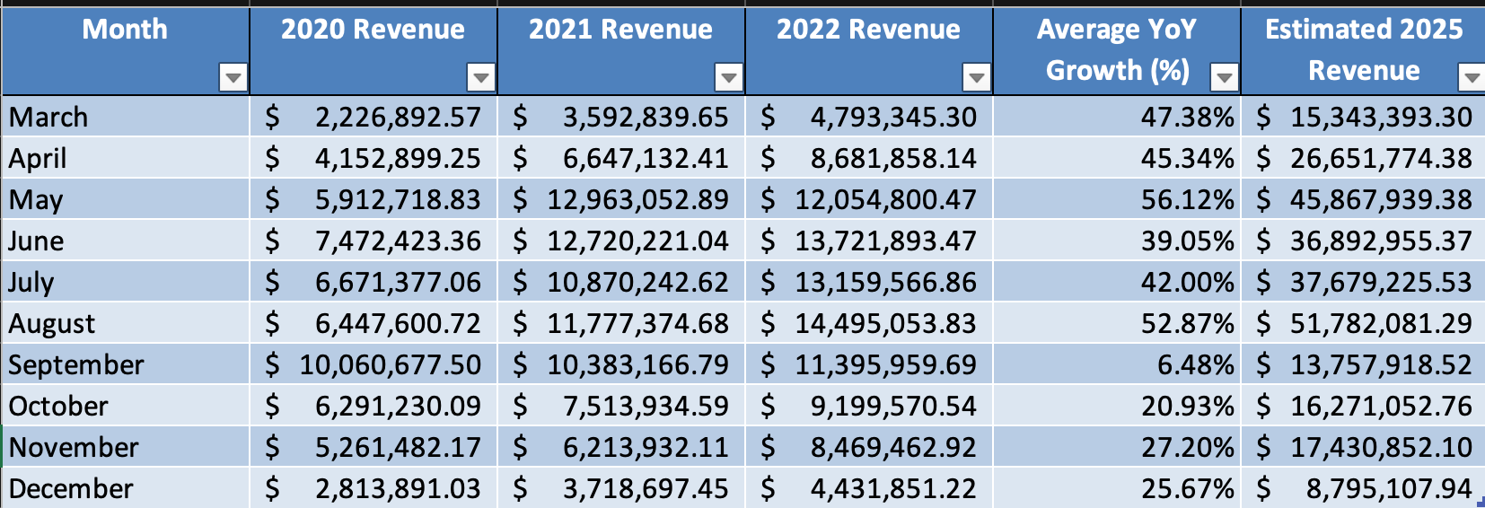
FINANCIAL INSIGHTS
REVENUE ANALYSIS
High YoY Growth
Lowest YoY

Slide 10
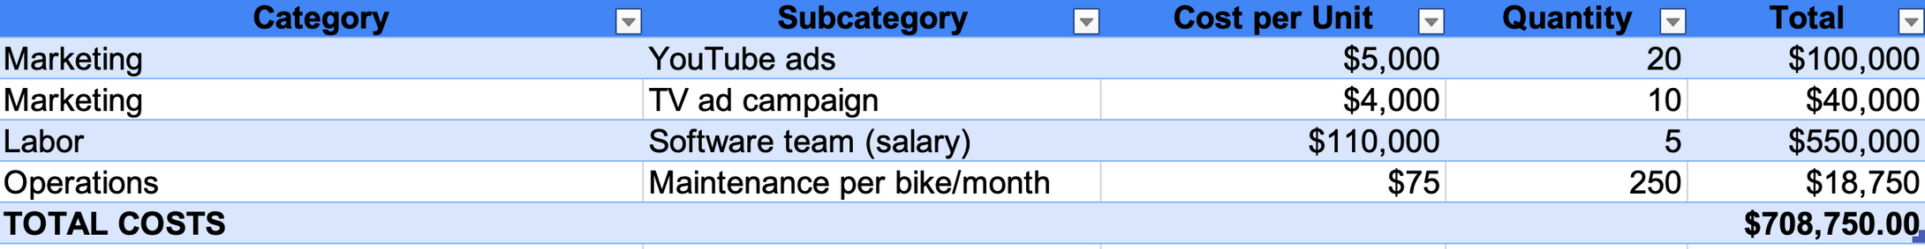
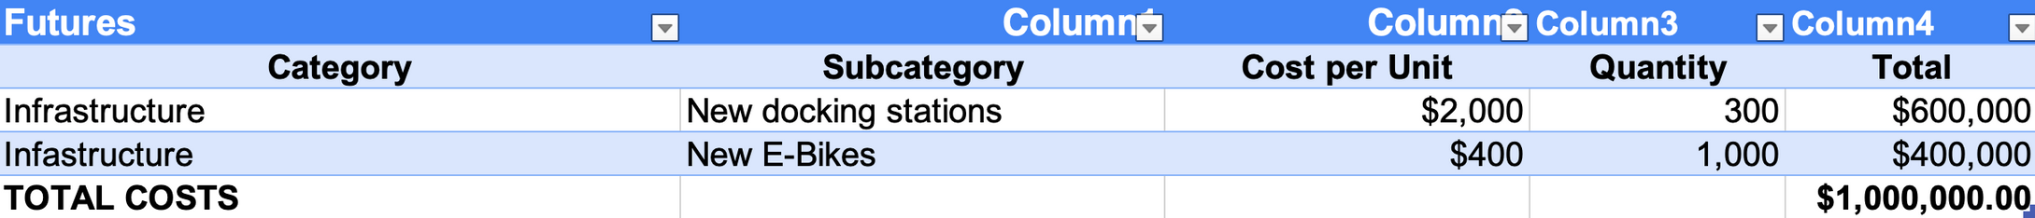
FINANCIAL INSIGHTS
COST BREAKDOWN

Slide 11
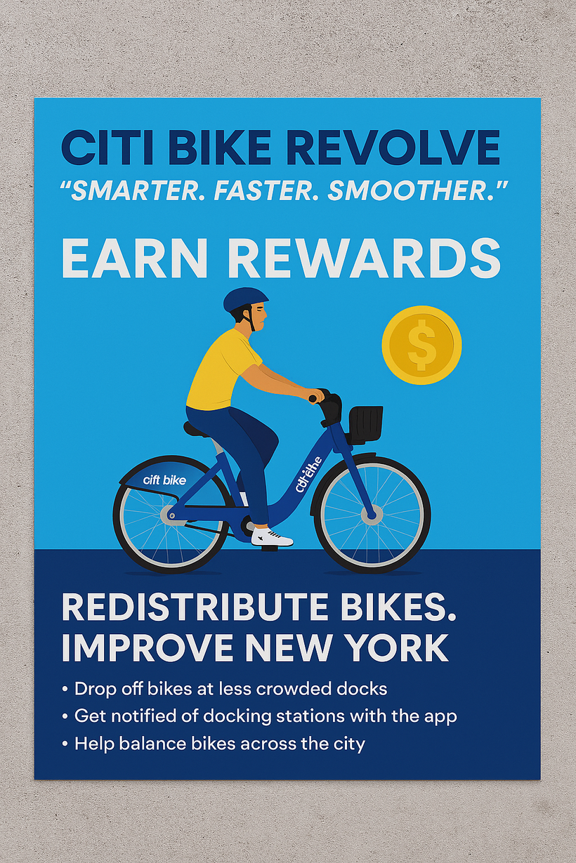

CITI BIKE MARKETING
Leveraging our motto:
Post flyers around the city
Promote: Summer
Highlights incentive program
Integrate in social media

Slide 12


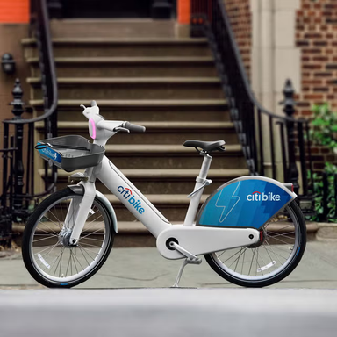
PARALLEL & SUPPORTING TECHNOLOGIES
Smart Docking & Predictive Maintenance
Rewards System
Advanced E-Bike Fleet
Reduces overcrowding
Lowers maintenance costs
Improves user experience
Increases user engagement & retention
Reduces manual redistribution costs
Keeps more bikes operational
Reduces labor costs
Lowers downtime for e-bikes

Slide 13
TECH COMPONENT
STATION REBALANCING
Our Goal: Ensure that users always have a bike to ride or dock to use
Reward System:
Suggests which stations to dock at, given a specific time and rewards users for doing so.
1) Users can earn rewards by leaving their bikes at stations with low bikes, encouraging app usage.
2) Using users to rebalance stations to help us meet our goal while minimizing need for intervention.

Slide 14
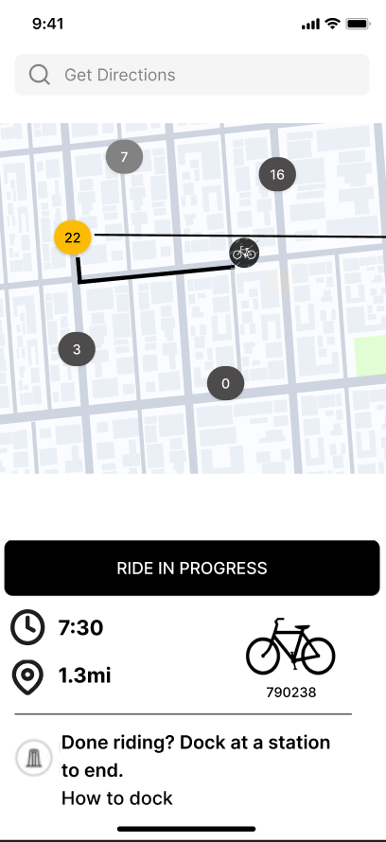
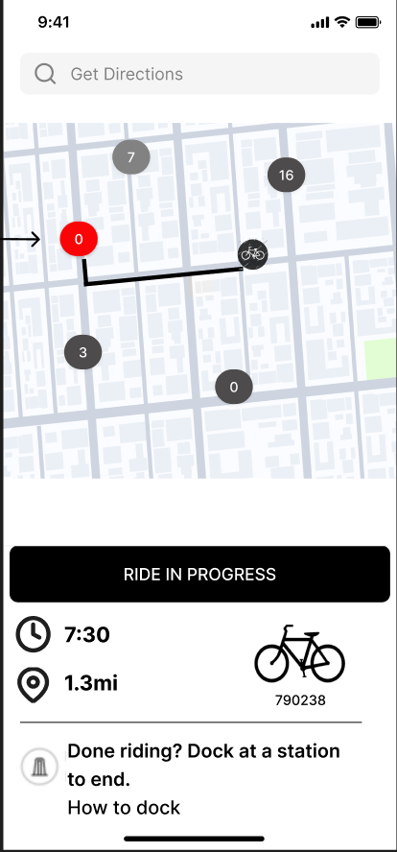
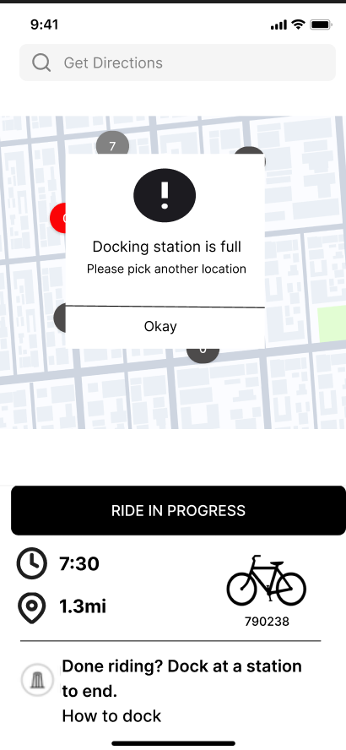
FRONT END MOCKUP

Slide 15
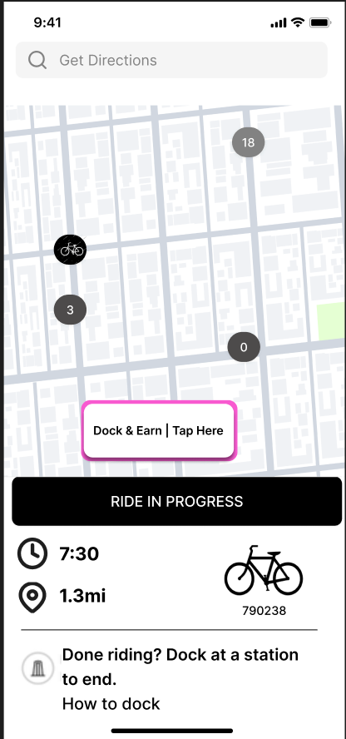
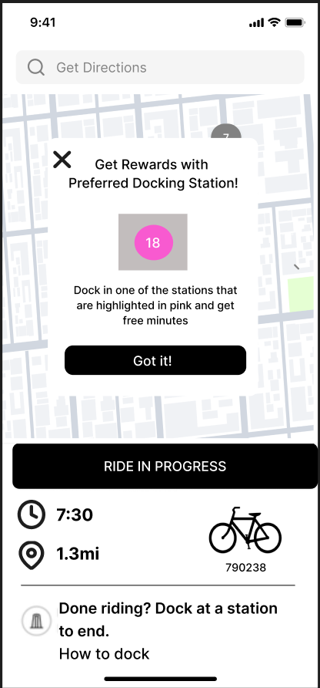
FRONT END MOCKUP

Slide 16



SECURING TRUST: DATA INTEGRITY
CITI BIKE’S NON NEGOTIABLES:
Data Collection:
Collects user data only via apps and payment systems to facilitate operations.
Compliance Standards:
New York SHIELD Act: Implement security measures to protect against unauthorized access and breaches
GDPR Best Practices: Adhere to maintain high privacy standards, regardless of location.
Lyft’s Privacy by Design: Integrate into all data systems to preemptively address privacy risks

Slide 17
CONCLUSION
Creating a bolder and data-driven future for urban transportation
Smarter Systems, Faster Growth, Smoother Rides
Revolve enhances user engagement & opens doors to new revenue streams

Slide 18
THANK YOU

